Slide 1
Housing Community Supports
Training: Service Encounter Documentation in HMIS
May 18, 2026
Welcome! Please put your name, role, and Org in the chat, and make sure your mic is muted

Slide 2
Today’s Training
Part 1: HCS Tenancy and Sustaining Services(TSS) and Housing Navigation(HN) Services Overview
Part 2: HCS HMIS Projects: New Service Category Structure
Part 3: HCS Service Note Quality Standards
Part 4: Next Steps

Slide 3
What is an “Encounter”?
An encounter is a distinct, documented service event that;
  Falls within allowable HCS Housing Navigation or Tenancy Sustaining Services activities;
  Is properly documented in HMIS using appropriate service category;
  Meets quality documentation standards;
Q: Do encounters *require* face-to-face/in-person contact?
A: No. Encounters may be in-person or telephonic if they include direct consumer contact.
Notes:
AS

Slide 4
Allowable HCS activities
HN and TSS services must stay within the scope of work defined in HCS Services As Needed contracts.
  Housing Navigation: Activities that help clients identify, obtain, and move into permanent housing, and
  Tenancy Sustaining Services: Activities that help clients maintain safe and stable tenancy after housing is secured.
Why this matters:
Accurate service documentation ensures client activities align with program intent and contract requirements.
Program requirements are designed to be in accordance with DHCS Community Supports Policy Guide
Notes:
AS

Slide 5
Allowable HCS activities – Examples
Examples from approved service specific activities include (not an exhaustive list):
Housing Navigation:
Assisting with housing search and offering housing options appropriate to client needs.
Helping obtain necessary documentation (e.g., ID for SSI applications).
Tenancy Sustaining:
Providing education on tenant/landlord rights and responsibilities.
Supporting budgeting and rent ledger reviews.
Coordinating with property managers or landlords.
Offering mediation, lease compliance support, and crisis planning to prevent eviction.
Making referrals or warm handoffs to ECM or community supports.
Notes:
AS

Slide 6
Introducing New HMIS Service Categories
Current System
Billable encounters are defined as “An instance of direct Provider-to-Consumer interaction (either in-person or via phone/other technology) during which HN/TSS services occurred”
These activities are documented as “Case Management” → “Individual Meeting”
Future Change (expected launch 6/1/26)
Services will be documented using multiple new categories aligned directly with allowable HN and TSS activities.
Example:
Allowable HN activity: “Assisting in searching for housing and presenting options.”
New corresponding HMIS category: Housing Search Assistance / Presenting Options.
Why the Change? – To strengthen alignment between documented services and HCS defined scope of work

Slide 7
New HMIS Service Categories
Q: Why is this change happening?
A: 1) Better alignment of service documentation with allowable activities defined in the HCS contracts
  Ensures HN/TSS services are aligned with contracted scope of work
2) More accurate reflection of the services provided
providers will be able to demonstrate (and analyze via HMIS reporting) the full range of HN/TSS services being provided
  3) Improved safeguards that services reflect enrollments
  if the services a client is receiving consistently fall outside of the allowable activities over a sustained time period, they are likely enrolled in the wrong service
Notes:
AS

Slide 8
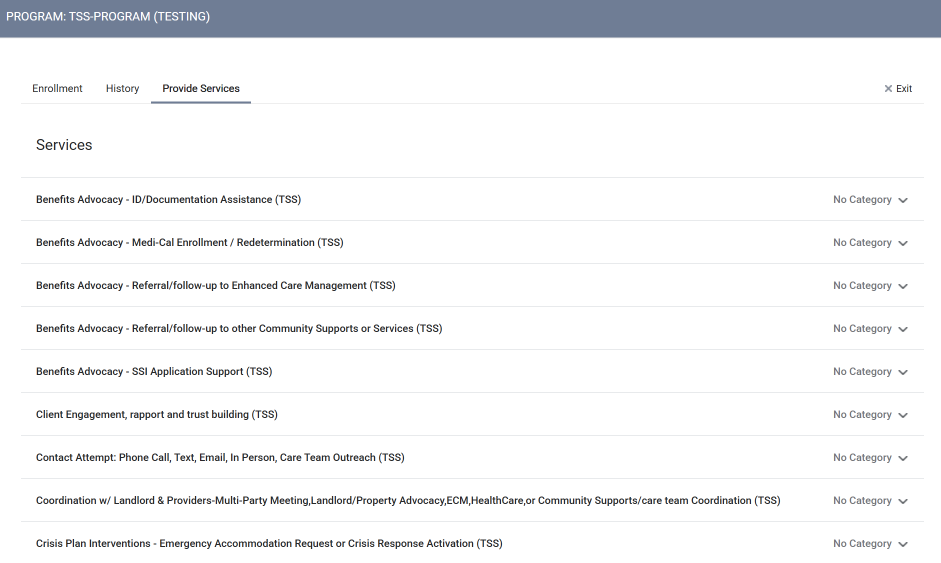
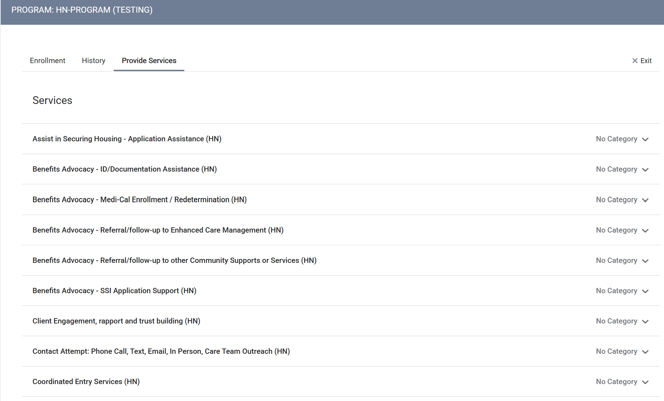
New HMIS Service Categories
New Structure:
  Multiple Categories:
Notes:
JL

Slide 9
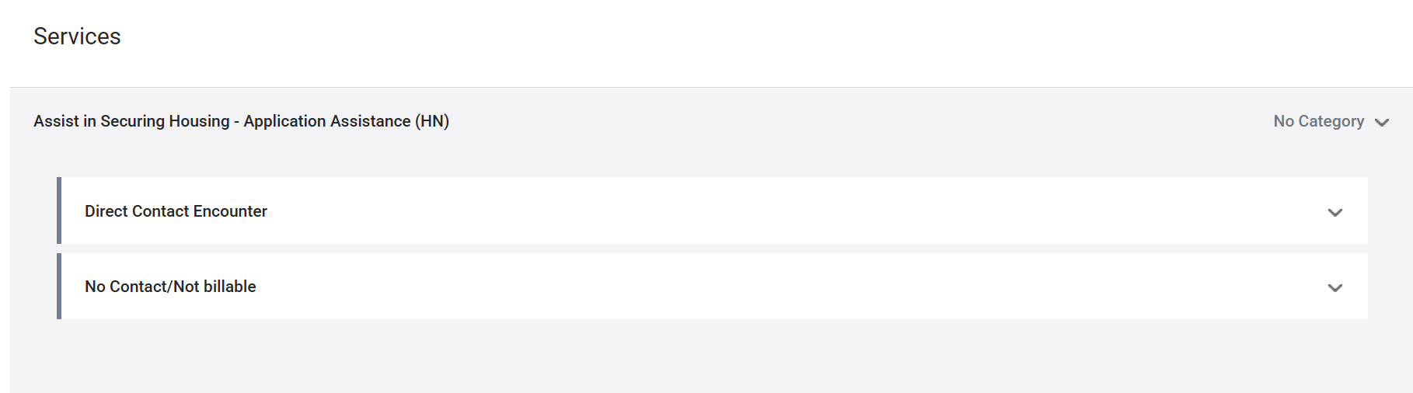
New HMIS Service Categories
New Structure:
  Two subcategories:
    #1: “Direct Contact Encounter” - use when the service provided had associated direct contact with the client
    #2: “No contact/not billable”- use when the service provided did not have associated direct contact with the client
    - Note: Some categories only have the “No contact/not billable” option. This is because those activities are not billable services regardless of whether there was direct contact or not.
Notes:
JL

Slide 10
Billable services crosswalk- Housing Navigation

Slide 11
Billable services crosswalk- Housing Navigation
Notes:
Housing Navigation is a pre-tenancy service. It's designed to support members in accessing housing, addressing barriers, and ensuring readiness. This is about structured, intentional work—not just helping with forms or referring to housing options.

Slide 12
Billable services crosswalk- Housing Navigation

Slide 13
Billable services crosswalk – Tenancy Sustaining Services

Slide 14
Billable services crosswalk - Tenancy Sustaining Services

Slide 15
Billable services crosswalk - Tenancy Sustaining Services

Slide 16
Example
Notes:
DEMO

Slide 17
Example
Service without successful client contact

Slide 18
Example
Client encounter and service happen on different days

Slide 19
Example
Multiple services across different allowable activities happen during a single encounter
Notes:
DEMO

Slide 20
HCS Service Note Quality Standards – Required Elements
Every billable encounter must include:
Service Type – HN or TSS and select the appropriate HMIS service category aligned with allowable activities;
Narrative – Provide a clear account of the encounter’s purpose, barriers encountered, actions taken, client/partner involvement, and outcomes; AND
Direct Contact – Must Be in-person, phone, or video
Notes:
AS

Slide 21
HCS Service Note Quality Standards - Narrative
Writing a strong narrative
Include the following in every encounter note
Purpose: What was the goal of this encounter? Goals may be ongoing or not yet achieved.
Barriers: Describe client‑, system‑, or task‑level obstacles that impacted progress (if any).
Actions Taken: What you did, what the client did, and any next steps that were planned.
Client/Partner Interaction: Who you communicated with and how it advanced the housing goal.
Outcome: What resulted from the encounter—even incremental progress counts.
Notes:
AS

Slide 22
HCS Service Note Quality Standards - Narrative
There is no required template, but your narrative must:
Clearly explain what occurred and why it matters for the client’s housing goals.
Be concise but specific, avoiding generic statements (e.g., “spoke with client”).
Demonstrate how the encounter aligns with HN activities (working toward obtaining housing) or TSS activities (supporting housing stability).
Show the connection between the selected service category and the work completed.
Notes:
AS

Slide 23
HCS Service Note Quality Standards
What is NOT considered an encounter?
  Services without direct client contact.
  Administrative tasks not tied to the client’s housing goals (e.g., scheduling, internal meetings, routine supervision, training).
  Administrative updates not involving direct provision of a service. Examples include:
    Community activities without involvement (e.g., “the client attended weekly coffee hour”)
    Receiving third‑party updates (e.g., “Homestretch emailed—client is #3 on waitlist”)
    Incidental contact (e.g., “the client dropped by to pick up her mail”)
    Welfare checks with no service engagement (e.g., “saw the client in passing in the hallway and said ‘Hi’” Or “visited the client to check in and offer services and the client said they are doing fine”)
Notes:
AS

Slide 24
What’s Next?
Guidance Documents/FAQs
View and test new service categories in HMIS training site- available now!
Follow up Q&A session: Thursday 5/28, 11am – 12:30
  Optional, drop in to listen/ask questions as needed
Service documentation-specific office hours starting in June- schedule TBD
Notes:
JL

Slide 25
THANK YOU!

